Slide 1

Mini Project (KCA353)
Odd Semester
Session 2024-25
E.C.H.O Voice Enabled Virtual Assistant
SHIVANI SAHU:-2300290140173
VINAYAK SAXENA:-2300290140202
SRISHTI BHATT:-2300290140178
Project Supervisor
Ms. Annu Yadav
(Assosciate Prof.)

Slide 2


Slide 3

CONTENTS
Introduction
Literature Review
Objective of the Project
Technology
Hardware Requirements
Software Requirements
Modules
Work Flow
Reports
References

Slide 4

INTRODUCTION
1.In this project, we aim to develop a versatile virtual assistant using Python.
2. The assistant will leverage speech recognition and natural language processing to understand and respond to user queries.
3. Key functionalities include converting speech to text, performing web searches, providing weather updates, and managing daily tasks.

Slide 5
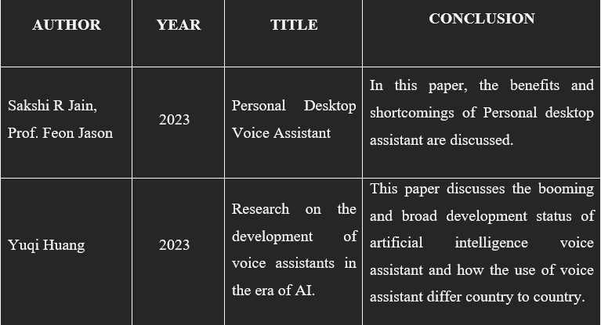
LITERATURE REVIEW

Slide 6

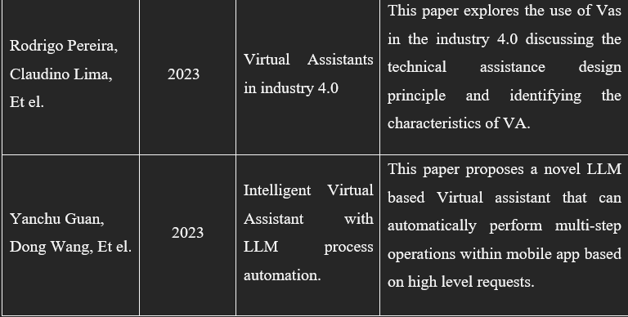
LITERATURE REVIEW

Slide 7

OBJECTIVE OF THE PROJECT
ENHANCE USER PRODUCTIVITY
PROVIDE REAL-TIME INFORMATION
IMPROVE USER INTERACTION
FACILITATE COLLABORATION

Slide 8

TECHNOLOGY (HARDWARE REQUIREMENT)
Computer or Laptop: Providing a platform to E.C.H.O for functioning.
Microphone: To give voice input.
Speakers/Headphones: For listening the result generated by E.C.H.O .
Internet Connection: Enabling E.C.H.O to help search and generate online results.

Slide 9

TECHNOLOGY (SOFTWARE REQUIREMENT)
Python: Python 3.6 or later is recommended.
IDE/ Code Editor: Pycharm, VS code, Jupyter notebook.
Libraries or packages: Pyttsx3, SpeechRecognition, NLTK, pyaudio etc,
API keys: API’s for fetching details weather, news etc.
Browser: Google Chrome, Microsoft Edge, Firefox.

Slide 10

MODULES
SPEECH RECOGNITION
Using libraries like SpeechRecognition and pyAudio
NATURAL LANGUAGE PROCESSING
Using library like NLTK fr understanding human speech
TEXT TO SPEECH
Using libraries like pyttsx3 for converting text to speech offline
API’s and WEB SEARCH
Making HTTP request and enable the E.C.H.O to search the web

Slide 11
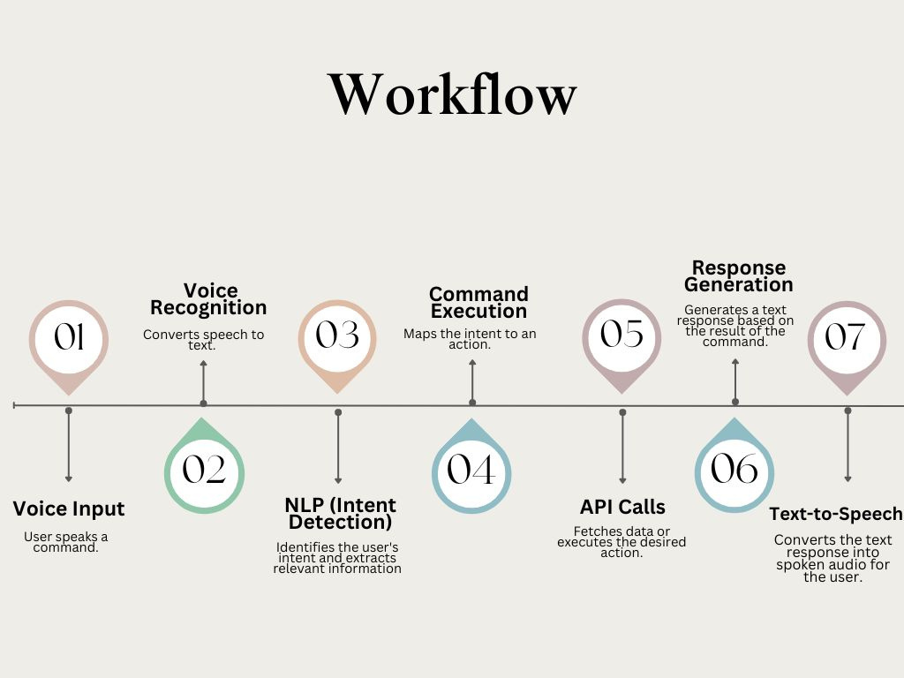
WORKFLOW

Slide 12
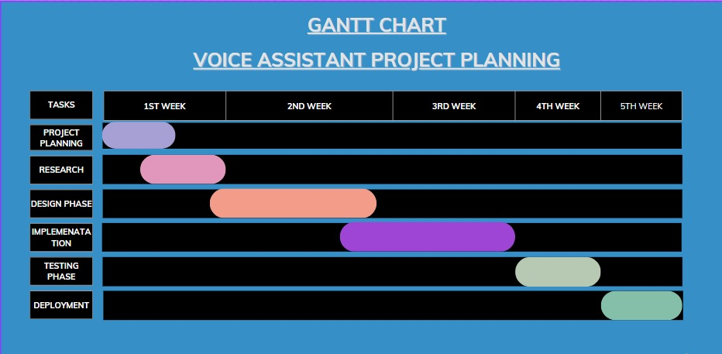
WORKFLOW/GANTT CHART

Slide 13


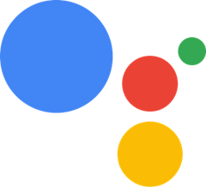
REPORT
Alexa was introduced in 2014, it has seen substantial growth and new features over the past five years.
Alexa’s integration into a wide range of devices, including smart speakers, home appliances, and automobiles, has expanded its user base. By 2023, Alexa was reported to be used in over 100 million devices
Launched in 2016, Google Assistant has become one of the most widely used virtual assistants.
Its integration with various Google services and third-party apps has driven its widespread adoption

Slide 14


REPORT
Siri, introduced in 2011, has continued to evolve with new features and improvements.
Apple’s focus on privacy and seamless integration across its ecosystem has contributed to Siri’s steady growth
Launched in 2017, Bixby is Samsung’s virtual assistant.
Bixby is integrated into Samsung smartphones, smart TVs, and home appliances. Despite facing competition from other virtual assistants, Bixby has maintained a presence in Samsung’s ecosystem.

Slide 15
REFERENCES
Jain, S. R., & Jason, F. (2023). Personal Desktop Voice Assistant. In this paper, the benefits and shortcomings of personal desktop assistants are discussed. Retrieved from URL
Huang, Y. (2023). Research on the Development of Voice Assistants in the Era of AI. This paper discusses the booming and broad development of artificial intelligence voice assistants and how their use differs across countries. Retrieved from URL
Pereira, R., Lima, C., & Et al. (2023). Virtual Assistants in Industry 4.0. This paper explores the use of virtual assistants in Industry 4.0, discussing the technical assistance design principles and identifying the characteristics of virtual assistants. Retrieved from URL
Guan, Y., Wang, D., & Et al. (2023). Intelligent Virtual Assistant with LLM Process Automation. This paper proposes a novel LLM-based virtual assistant that can automatically perform multi-step operations within mobile apps based on high-level requests. Retrieved from URL

Slide 16


